Slide 1
Pediatric Shock
Dr. Melat S. (PCHR3)
August, 2024

Slide 2
Outlines
Definition
Epidemiology
Types of shock
Pathophysiology of shock
Clinical manifestation of shock
Diagnosis
Laboratory findings
Treatment of shock
Prognosis
References

Slide 3
Definition
Shock is an acute, life-threatening process of cardiovascular insufficiency characterized by inadequate delivery of oxygen and nutrients (e.g., glucose) by the circulatory system to meet the metabolic demands of vital organs that results in cellular dysfunction and injury.

Slide 4
Epidemiology
Shock occurs in approximately 2% of all hospitalized infants, children, and adults in developed countries,
And the mortality rate varies substantially depending on the etiology and clinical circumstances.

Slide 5
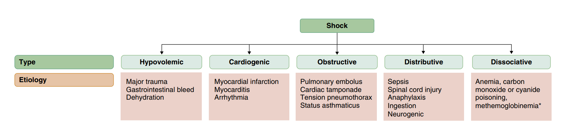
Types of Shock

Slide 6
Hypovolemic shock
The most common cause of shock in children worldwide.
Inadequate tissue perfusion usually from decreased intravascular volume as the result of fluid loss.
Etiologies
Vomiting and/or diarrhea, Osmotic diuresis, Hemorrhage, Inadequate fluid intake, Insensible losses

Slide 7
Cardiogenic shock
Cardiac pump failure secondary to Poor myocardial function.
Etiologies
Is seen in patients with congenital heart disease (before or after surgery, including heart transplantation) or those with congenital or acquired cardiomyopathies, including acute myocarditis.

Slide 8
Obstructive shock
stems from any lesion that creates a mechanical impediment to ventricular blood outflow.
Etiologies
Pericardial tamponade
Tension pneumothorax
Pulmonary embolism
Aortic coarctation
Interrupted aortic arch and
Critical aortic valve stenosis

Slide 9
Distributive shock
Is caused by inappropriate vasodilation, pooling of blood in the peripheral vasculature, leakage of blood plasma into the interstitium through a compromised endothelial barrier.
Etiologies
Sepsis
Anaphylaxis
And accidental or intentional drug overdose (e.g., calcium channel blockers, atypical antipsychotics).

Slide 10
Neurogenic shock
Is a type of distributive shock caused by a sudden disruption of sympathetic nerve stimulation to the vascular smooth muscle leading to a profound decrease in vasomotor tone.
Etiologies
severe traumatic brain or
cervical spine injury.

Slide 11
Dissociative shock
Is a special category of shock in which cellular oxygen delivery is severely impaired despite sustained or supra normal tissue perfusion.
Etiologies
Methemoglobinemia (from drugs like cotrimozazole,dapsone,pesticides
carbon monoxide poisoning

Slide 12
Septic Shock
Is life-threatening cardiovascular dysfunction in patients with suspected or confirmed infection .
Etiologies :-
Could be bacterial, viral , fungal infections

Slide 13
Pathophysiology
An initial insult triggers shock, leading to inadequate oxygen delivery to organs and tissues.
Compensatory mechanisms attempt to maintain blood pressure by increasing cardiac output and systemic vascular resistance.
The body also attempts to optimize oxygen delivery to the tissues by increasing oxygen extraction and redistributing blood flow to the brain, heart, and kidneys at the expense of the skin and gastrointestinal tract.

Slide 14
…cont…
These responses lead to an initial state of compensated shock in which BP is maintained.
If treatment is not initiated or is inadequate during this period, decompensated shock develops, with hypotension and tissue damage that may lead to multisystem organ dysfunction and, ultimately, death

Slide 15
In the early phases of shock, multiple compensatory physiologic mechanisms act to maintain BP and preserve tissue perfusion and oxygen delivery.
Increases in heart rate, stroke volume, and vascular smooth muscle tone
Greater carbon dioxide elimination
Renal excretion of hydrogen ions and retention of bicarbonate

Slide 16
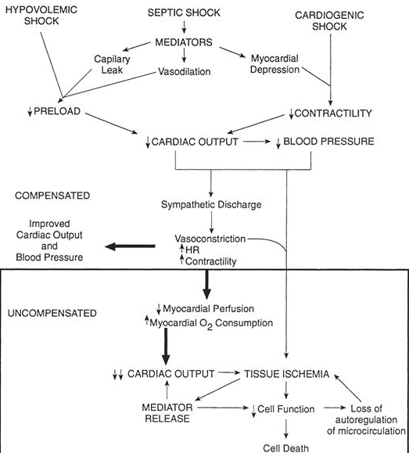
Sequence of pathophysiologic events in clinical shock states

Slide 17
CLINICAL MANIFESTATIONS
The clinical presentation of shock depends in part on the underlying etiology,
But if unrecognized and untreated, all forms of shock follow a common progression of clinical signs and pathophysiologic changes that may ultimately lead to irreversible organ injury and death.
Among the first physiologic responses is sympathetic adrenergic system activation and its related signs and symptoms.

Slide 18
Shock may initially manifest as only tachycardia, with or without tachypnea.
Progression leads to decreased urine output, poor peripheral perfusion, respiratory distress or failure, alteration of mental status, and low BP.

Slide 19
A significant misconception is that shock occurs only with low BP.
Hypotension is often a late finding, especially in infants and young children
And is not a criterion for the diagnosis of shock because of a complex set of compensatory mechanisms that attempt to preserve BP and peripheral perfusion.
Hypotension reflects an advanced state of uncompensated shock and is associated with increased morbidity and mortality .

Slide 20

Timing
Compensated
Hypotensive
Cardiac Arrest
Possibly Hours
Potentially Minutes
Notes:
Early recognition & timely intervention are critical to halting the progression from compensated shock to hypotensive shock to cardiopulmonary failure & arrest

Slide 21
Hypovolemic shock
Tachycardia
Orthostatic hypotension
Dry mucous membranes,
Dry axillae
Poor skin turgor,
Decreased urine output.
Normal or slightly cool distal extremities, and
Normal, decreased, or absent peripheral pulse

Slide 22
Cardiogenic shock
Tachypnea
cool extremities
delayed capillary filling time
poor peripheral and/or central pulses
reduced pulse pressure
declining mental status
Decrease urine output

Slide 23
Obstructive shock
Tachycardia
Delayed capillary refill
Cool extremities
Diminished peripheral pulses
Decreased pulse pressure
Presence of pulsus paradoxus

Slide 24
Obstructive shock due to tension pneumothorax typically includes signs of respiratory distress, hypoxia, and diminished breath sounds.
Pericardial tamponade indicate by Beck’s triad of hypotension, jugular vein distention, and muffled heart sounds.

Slide 25
A saddle pulmonary embolism often presents with a sudden cardiac arrest.
Left-heart obstructive lesions may present in newborns with discrepant perfusion of the upper and lower extremities.

Slide 26
Distributive shock
#includes signs of vasodilation, including
Tachycardia
flash capillary refill
warm extremities
bounding peripheral pulses, and
increased pulse pressure, often with diastolic hypotension.

Slide 27
In neurogenic shock, tachycardia may be absent or frank bradycardia may be present.
Similar to distributive shock, signs of vasodilation may be present, although in the immediate phase, the patient can feel cool peripherally with delayed capillary refill.

Slide 28
Septic shock
Present with wide spectrum of presenting signs and symptoms.
A key historical clue is
The presence of fever (or hypothermia)
Along with evidence for either a systemic (e.g., bacteremia, rickettsial disease, fungemia, viremia) or localized (e.g., meningitis, pneumonia, pyelonephritis, peritonitis, necrotizing fasciitis) infection.

Slide 29
Infants and young children most commonly present with “cold shock,” with features of hypovolemic and cardiogenic shock predominating, including
Tachycardia
delayed capillary refill
cool extremities
diminished peripheral pulses, and
decreased pulse pressure.

Slide 30
Older children and adolescents, especially those with sepsis from indwelling central venous catheters, more commonly present with “warm shock” that resembles distributive shock, including
Tachycardia
Flash capillary refill
Warm extremities
Bounding peripheral pulses, and
Increased pulse pressure

Slide 31
Regardless of etiology, uncompensated shock, presents with:-
Hypotension
High SVR
Decreased cardiac output
Respiratory failure
Obtundation, and
Oliguria

Slide 32
Additional clinical findings in shock include cutaneous lesions such as petechiae, diffuse erythema, ecchymosis, ecthyma gangrenosum, and peripheral gangrene.
Jaundice can be present either as a sign of infection or as a result of MODS.

Slide 33

DIAGNOSIS
Shock is a clinical diagnosis that should be primarily based on a thorough history and physical examination .

Slide 34
The physical examination should include rapid assessment of-
vital signs (including pulse oximetry)
mental status/level of consciousness
extremity temperature
peripheral and central pulses
capillary refill, and
presence of rashes or skin changes

Slide 35
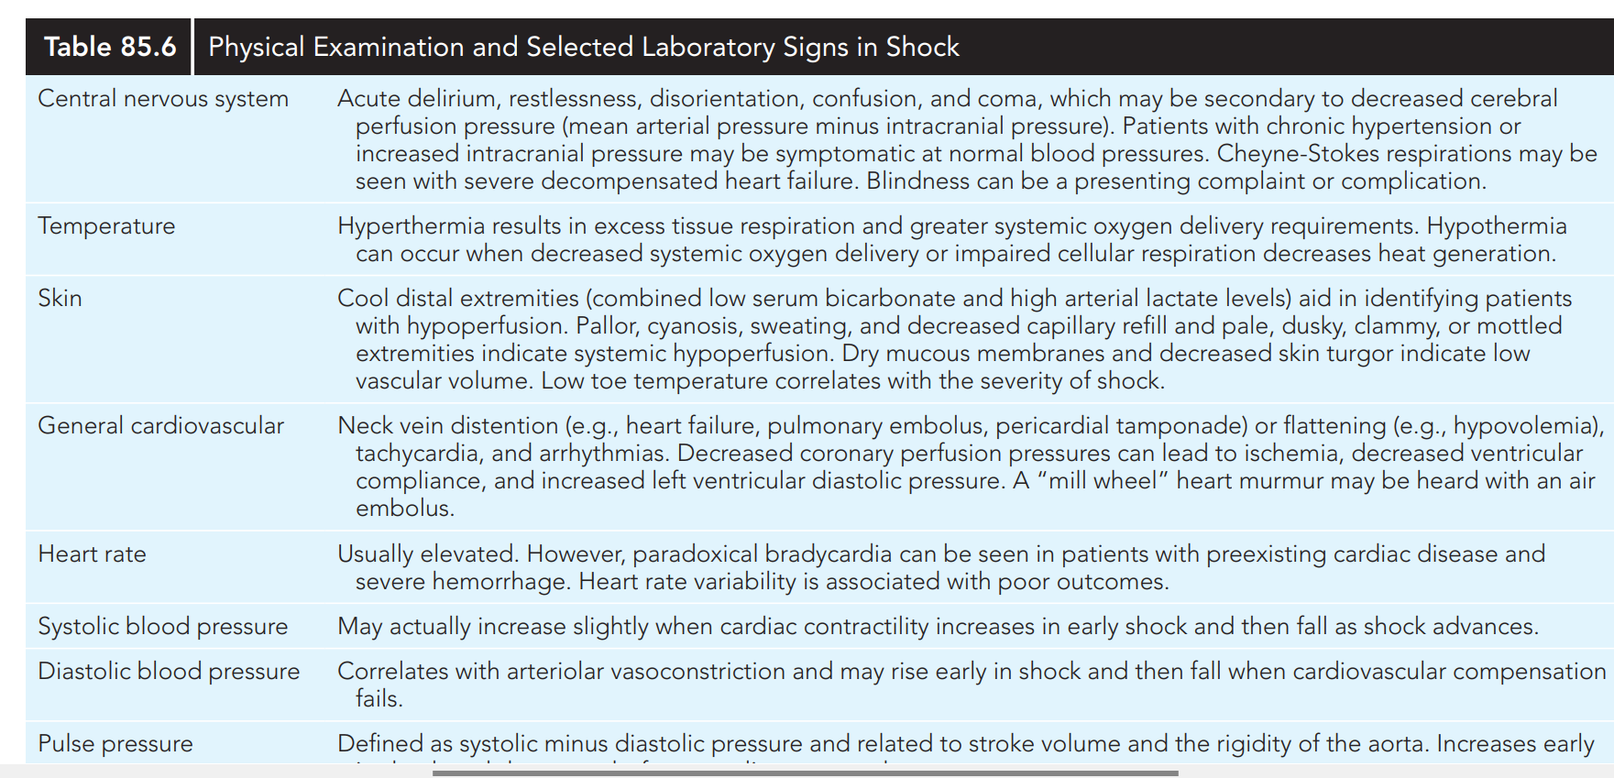

Slide 36
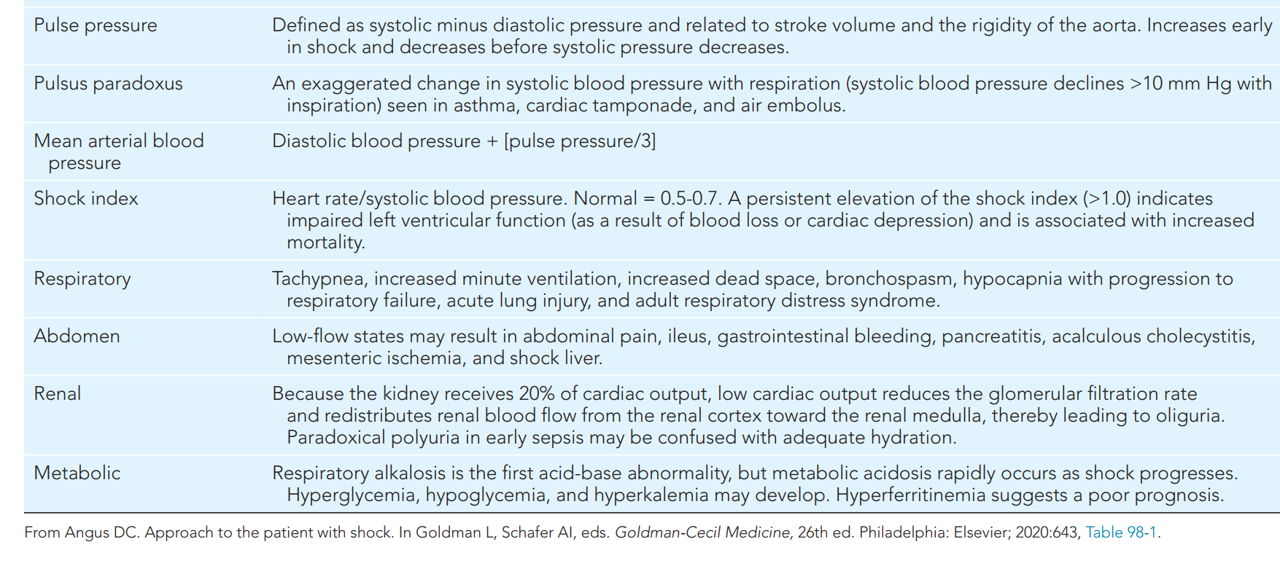

Slide 37
Increasingly, point-of-care ultrasound (POCUS) is being incorporated into the initial assessment of children with shock to assess
Intravascular volume status
Likelihood of a positive hemodynamic response to fluid therapy, and
Myocardial function

Slide 38
Septic shock
Sepsis in children is operationalized as a Phoenix Sepsis Score
Of at least 2 points from a composite four-organ system model that includes criteria for
Respiratory
Neurologic
Coagulation and
cardiovascular dysfunction,
with septic shock requiring at least 1 point in the cardiovascular subscore .

Slide 39
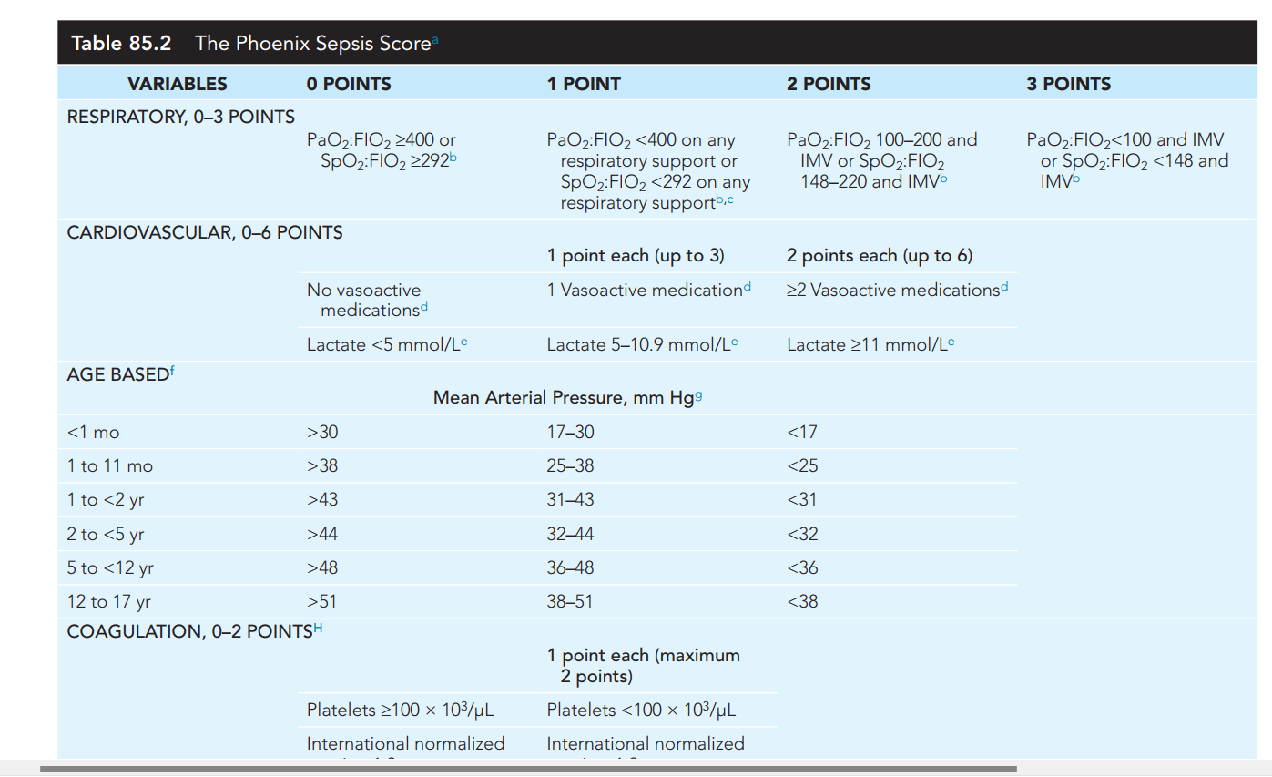

Slide 40
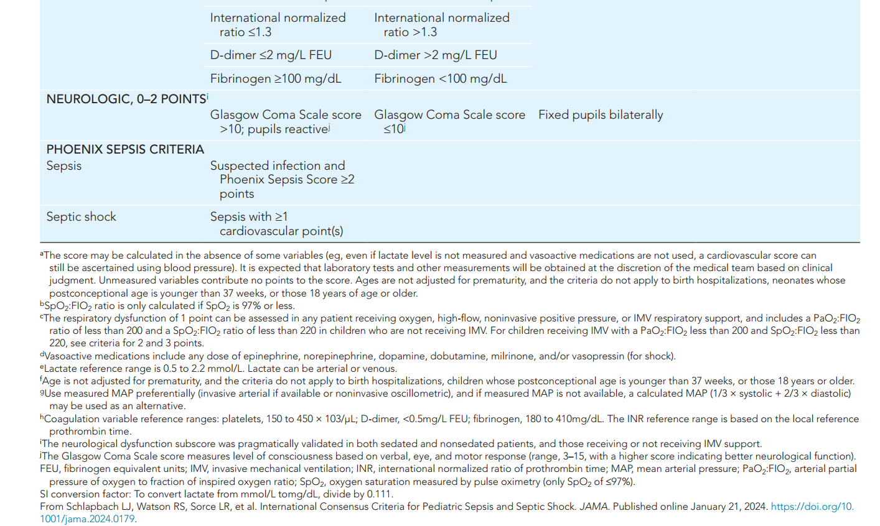

Slide 41
LABORATORY FINDINGS
Although the initial diagnosis of shock can and should be based on clinical data from the history and physical examination,
The overall evaluation of shock should also include early laboratory testing to screen for
hyperlactatemia (as a sign of increased anaerobic metabolism), acidemia, and
electrolyte disturbances, including hypoglycemia and hypocalcemia.

Slide 42
Laboratory evidence of concurrent MODS should also be sought, including
A complete blood count
Renal function tests
Liver function tests, and
Coagulation profile (including fibrinogen and d-dimer or fibrin split products).

Slide 43
Elevated neutrophil counts with increased immature forms (i.e., bands, myelocytes, promyelocytes) and elevated CRP and procalcitonin levels may be seen with infection.
A blood gas analysis may be helpful to assess the degree of respiratory dysfunction, and an elevated venous to arterial Pco2 gap ≥5 mm Hg (≥0.67 KPa) may signify an early shock state.
NB :- For septic shock, at least one blood culture should be collected along with other cultures as supported by the history and physical.

Slide 44
TREATMENT
General principles
Initial management begins with early recognition of the compensated or uncompensated shock state based on the history, physical examination, and laboratory assessments .
Once recognized, immediate efforts to restore oxygen (and other nutrient) delivery by supporting the circulation and identifying and reversing the underlying etiology of shock are necessary .

Slide 45
Restoration of oxygen delivery includes
ensuring airway patency and adequacy of breathing
providing supplemental oxygen if hypoxemia (Spo2 <92–94%) is present
establishing vascular access
expanding the circulating blood volume
supporting the cardiac and vascular system with appropriate vasoactive agents when necessary, and
frequently reassessing the patient’s response to initial therapy.

Slide 46
Indications for intubation and mechanical ventilation include
acute hypoxemic or hypercarbic respiratory failure or
persistence of circulatory failure
In which case a reduction in metabolic demand facilitated by sedation and ventilatory support can be helpful.
Sedation and endotracheal intubation reduce the work of breathing, which can divert cardiac output away from the muscles of respiration and improve perfusion to other organs.

Slide 47
Vascular access should be established within the first few minutes of shock recognition, ideally with at least two large-bore peripheral intravenous (IV) catheters.
If peripheral IV access is not successful within 5 minutes, intraosseous (IO) access should be established until more definitive access is secured .

Slide 48
Central venous access should be considered for patients with:
unstable peripheral IV access
persistence of shock despite 40-60 mL/kg fluid bolus therapy (fluid-refractory shock), or
need for vasoactive medications
NB :- Placement of an arterial catheter should be considered for patients with fluid-refractory shock who require active titration of vasoactive medications .

Slide 49
Volume resuscitation with fluid bolus therapy in aliquots of 10-20 mL/kg pushed over 5-10 minutes is currently recommended for most types of shock and in most settings in children.
Several observational studies have demonstrated improved outcomes in children with shock with initial volume resuscitation.

Slide 50
With titration of fluid administration, improvements in hemodynamic targets including:
Decrease in HR
Increase in BP
Normalization of capillary refill
Peripheral pulse strength, and
Extremity temperature
Improved urine output; and
Fall in blood lactate by ≥10–20%.

Slide 51
Fluid boluses totaling up to 60 mL/kg may be needed in the first hour of resuscitation, with volumes exceeding 200 mL/kg over several hours.
Importantly, not all children with shock will continue to improve with repeated volume resuscitation particularly those with cardiogenic and dissociative shock, severe anemia, or malnutrition.

Slide 52
Before repeating a fluid bolus, the clinician should determine if the patient responded in a hemodynamically desirable way after the prior fluid bolus and ensure that signs of fluid overload,
such as rales
gallop rhythm, or
hepatomegaly, have not developed.

Slide 53
For children with evidence of fluid overload, adequate intravascular volume, or lack of hemodynamic improvement with prior fluid boluses, resuscitation should shift from volume resuscitation to vasoactive medications.

Slide 54
The optimal fluid type for initial shock resuscitation remains a matter of debate.
Most studies have not demonstrated a clear benefit for use of colloids, such as 4–5% albumin, over crystalloids, though there may be a small clinical benefit for resuscitation with colloids in septic shock.
Because crystalloids are inexpensive, easy to administer, and readily available, current guidelines generally recommend initial resuscitation begin with these fluids.

Slide 55
Exceptions include children with hemorrhagic shock and dissociative shock resulting from severe anemia for whom early blood product transfusion is preferred .
Crystalloid volume resuscitation may include 0.9% normal saline or balanced/buffered fluids, such as lactated Ringer solution, Hartmann solution, and Plasma-Lyte.

Slide 56
The criteria to transfuse red blood cells are not clear, though it is reasonable to target hemoglobin levels >9 g/dL for children
who remain hemodynamically unstable with low Spo2 and/or
high blood lactate despite other interventions.
Notably, transfusion of plasma or platelets should be reserved to treat active bleeding or reduce risk of bleeding before an invasive procedure rather than used solely to correct laboratory abnormalities or as volume expanders.

Slide 57
Vasoactive medications should be initiated for children with fluid refractory shock, With early consideration for inotropes, such as
epinephrine, when myocardial dysfunction is present and
vasopressors, such as norepinephrine, when vasoplegia is present.

Slide 58
For children with septic shock, trials have demonstrated that epinephrine as first-line vasoactive therapy is more effective at reducing mortality than dopamine.
As such, epinephrine is the preferred first-line vasoactive therapy for fluid-refractory septic shock.

Slide 59
Metabolic abnormalities, such as hypoglycemia and hypocalcemia, may precipitate or worsen shock.
Blood glucose and ionized calcium can both be measured rapidly via bedside point-of-care testing, and if present, hypoglycemia and hypocalcemia should be corrected during the initial resuscitation.

Slide 60
Specific Management By shock type
For children with cardiogenic shock must be reversed by early treatment with inotropes, such as epinephrine, dopamine, dobutamine, or milrinone.
Gentle volume resuscitation to optimize preload may also be helpful, but excessive fluid administration can worsen volume overload and further compromise heart function.

Slide 61
In obstructive shock, action is often needed to relieve the point of mechanical obstruction.
Examples include
Thoracentesis for tension pneumothorax,
Pericardiocentesis for cardiac tamponade, and
Administration of systemic fibrinolytic medications for pulmonary embolism.
For neonates or young infants (typically <2-3 weeks of age) with shock caused by ductal-dependent congenital heart disease, a prostaglandin infusion should be started to maintain systemic cardiac output while preparing to transfer to a pediatric specialty center.

Slide 62
The management of septic shock should follow the recommendations of the 2020 Surviving Sepsis Campaign International Guidelines for the Management of Septic Shock and Sepsis-Associated Organ Dysfunction in Children .
These guidelines recommend six initial management steps in the first hour after shock recognition including
Obtaining IV/IO access
Collecting a blood culture,
Administering empiric broad-spectrum antibiotics
Measuring lactate
Providing volume resuscitation, and
Initiating vasoactive medication if shock persists despite fluid therapy.

Slide 63
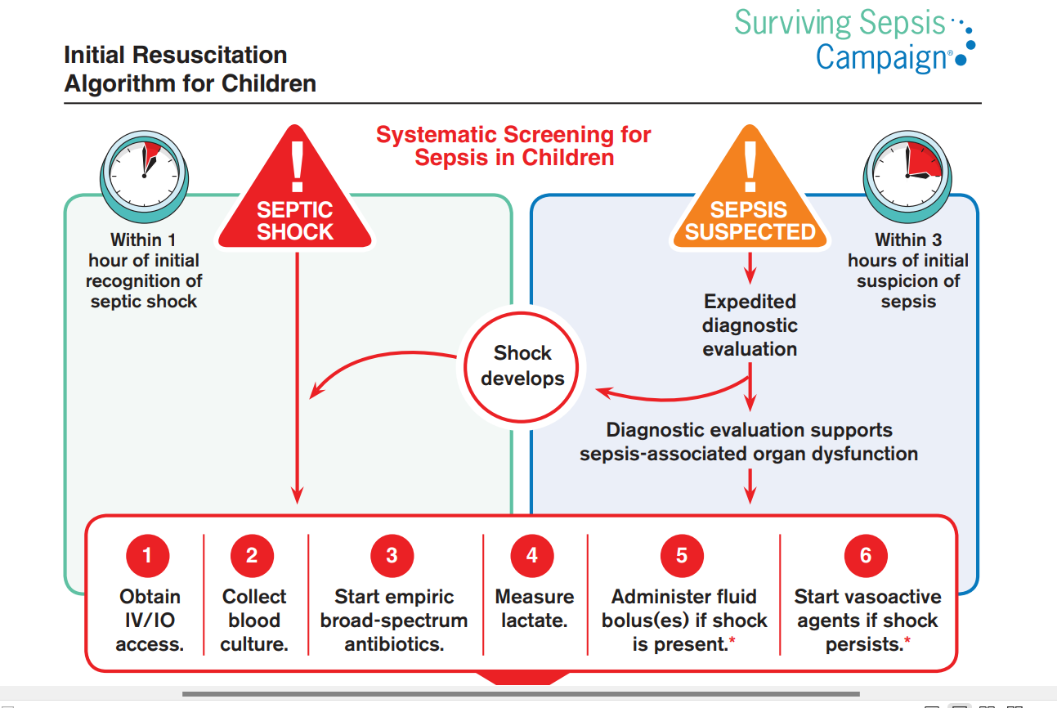
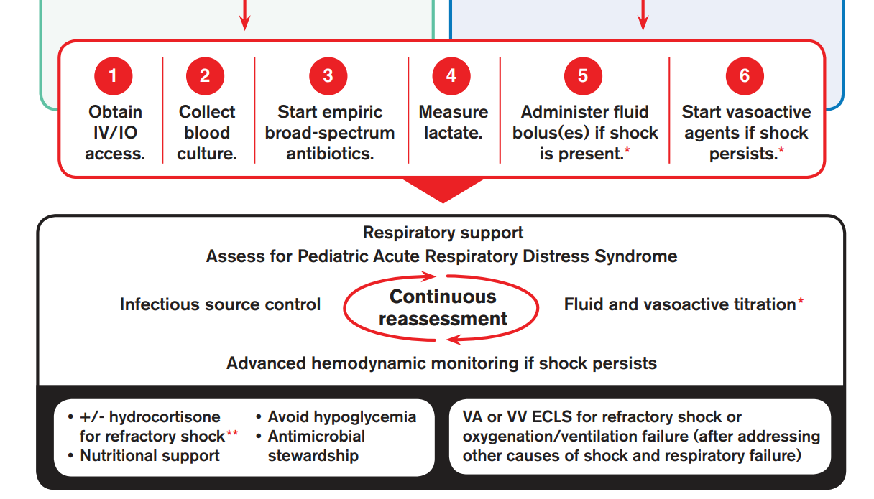
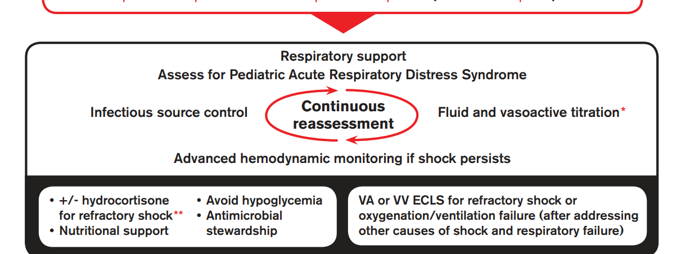

Slide 64
Notably, the Surviving Sepsis Campaign suggests volume resuscitation with up to 40-60 mL/kg in bolus fluid (10-20 mL/kg per bolus) over the first hour, titrated to clinical markers for children with septic shock.
In geographic regions that have access to intensive care (either locally or via transport) or in any setting when hypotension is present.

Slide 65
Fluid-Refractory and Catecholamine-Resistant Shock
If shock persists despite volume resuscitation and vasoactive support with an initial catecholaminergic agent, such as epinephrine, the child has fluid-refractory and catecholamine-resistant shock.
second-line vasoactive medications, stress-dose corticosteroids, and extracorporeal membrane oxygenation (ECMO).

Slide 66
Stress-dose corticosteroids are indicated for patients with septic shock who have absolute adrenal insufficiency, such as that caused by
congenital adrenal hyperplasia
septic shock with purpura,
prior steroid therapy for chronic illness, or
Hypopituitarism
And can be considered for children with fluid-refractory, catecholamine-resistant shock without a reversible etiology .

Slide 67
Second-line vasoactive therapy should be considered for patients in whom shock persists despite titration of the initial vasoactive agent.
For patients with “warm” shock or evidence of low SVR initially treated with norepinephrine, the addition of vasopressin or epinephrine may be considered.

Slide 68
For patients with “cold” shock or evidence of myocardial dysfunction, priority should be given to improving cardiac contractility with inotropes.
First-line therapy with epinephrine is recommended, with addition of dopamine, dobutamine, or norepinephrine as second line agents.

Slide 69
Shock Management is severe acute manutrition
The four key steps to manage shock are:
Give oxygen
Give 10% Glucose 5 ml/kg by IV
Keep the child warm
Give IV fluids Infuse IV fluid at 15ml/kg over 1 hour
If respiratory rate and pulse rate are slower after one hour, the child is improving Repeat the same amount of IV fluids for another hour

Slide 70
Use one of the following solutions
Ringer’s lactate solution with 5per cent glucose
0.9 per cent normal saline with 5per cent glucose
If either of these are used, add sterile potassium chloride (20 Mmol/l) if possible.
After two hours of IV fluids, switch to oral or NG rehydration with ReSoMal
Give 5-10 ml/kg ReSoMal in alternate hours with F-75 for up to 10 hours or until fully rehydrated.

Slide 71
If the respiratory rate and pulse rate increase and child is gaining weight, stop the IV rehydration and assume septic or cardiogenic shock.

Slide 72
Management of septic shock with SAM
All patients with signs of septic shock should immediately:
Be given broad-spectrum antibiotics
Be kept warm to prevent hypothermia or
Be treated or ensure hypoglycemia is prevented

Slide 73
Give maintenance IV fluids (4 ml/kg/hour) while waiting for blood transfusion.
When blood is available, stop all oral intake and IV fluids, give a diuretic to make room for the blood.
Then transfuse whole fresh blood at 10 ml/kg slowly over three hours
If there are signs of heart failure, give packed cells

Slide 74
Targets for Shock Reversal
Clinical signs include:-
A decrease in HR and respiratory rate,
Increase in BP
Improved urine output to >0.5 mL/ kg/hr
Normalization of mental status
Decreased capillary refill time
Warmth of distal extremities, and
Improved peripheral pulses.

Slide 75
On laboratory exam :-
Decreasing trend in blood lactate levels
Blood pH and base deficit
Other parameters to monitor for improvement in shock include serial POCUS to assess volume status, cardiac output.

Slide 76
PROGNOSIS
In septic shock, mortality rates are as low as 3% in previously healthy children and 6–9% in children with chronic illness (compared with 25–30% in adults).
The risk of death involves a complex interaction of factors, including the underlying etiology, presence of chronic illness, host immune response, and timing of recognition and therapy.

